Slide 1
EMERGING ICT TECH
Knowledge Overview

Slide 2
Thinking Critical In The Workplace
What is critical thinking?
Why critical thinking matters
Applying critical thinking at work

Slide 3
Sociocentric thinking
We are born with a self-centered outlook, and as we grow we develop a more sociocentric view of the world.
Each of these types of thinking is essentially unconscious. By contrast, critical thinking
requires conscious effort and must be developed.

Slide 4
Rational and irrational thinking
The human brain uses both rational and irrational thinking, but considers all
thinking to be rational.

Slide 5
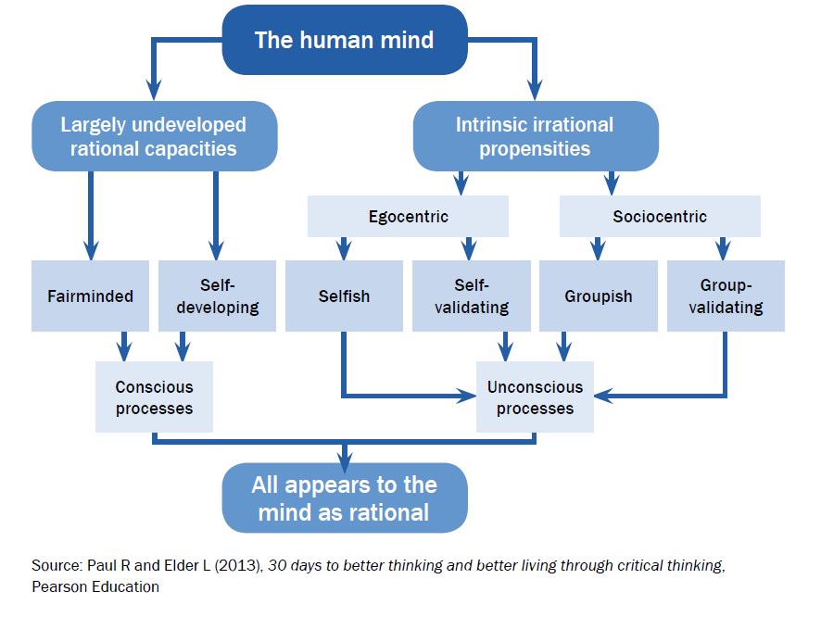
Rational and irrational thinking

Slide 6
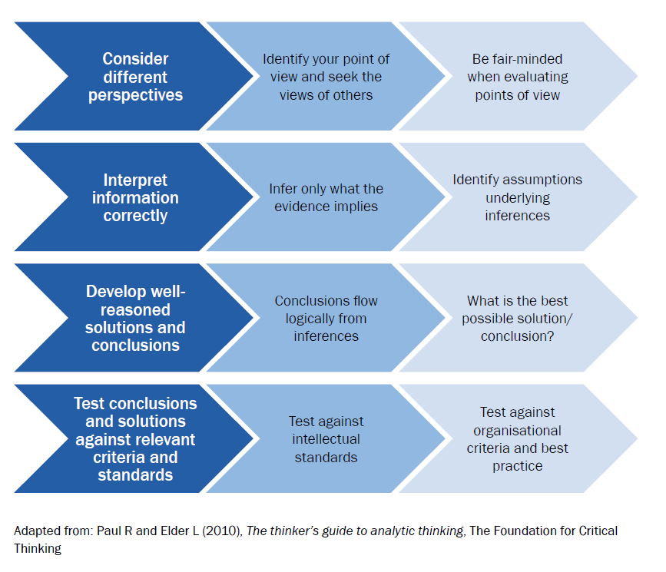

Slide 7
Intellectual standards
Intellectual standards provide a basis for testing your thinking.
Intellectual standards enable you to check the quality of your thinking. They are essentially
a series of questions that you should ask yourself at various points in the critical thinking
process. There are many universal standards used across different disciplines.

Slide 8
Critical Thinking Example
On the morning of the launch, NASA was advised by Morton Thiokol about the O-ring
safety concern and advised not to launch. NASA asked Morton Thiokol to review their
advice. The Morton Thiokol management team then met with their engineers, who
expressed strongly that the launch be postponed because the freezing temperatures might
compromise the integrity of the O-ring. The Morton Thiokol management team ignored the
advice of the engineers and no one on the management team expressed a concern when they
reached that decision. They gave NASA the all clear to launch. Morton Thiokol did not want
to disappoint their major client and NASA was under pressure to go ahead with the launch.
The concerns expressed by Morton Thiokol engineers to NASA did not make their way to
the senior NASA decision-makers.

Slide 9
Key Characteristics
What are key characteristics of concepts related to the critical thinking process?
- Observation
- Curiosity
- Objectivity
- Introspection

Slide 10
Rational Thinking?
To be a critical thinker is to be appropriately moved by reasons. To be a rational person is to believe and act on the basis of reasons. There is then a deep conceptual connection, by way of the notion of reasons, between critical thinkers and rational persons. This is the reason why critical thinking is sometimes referred to as rational thinking.

Slide 11
Benefits Of Critical Thinking
How could we apply critical thinking to avoid the following situations in a business?
• having the same range of products and services year after year/
• implementing a new process that drives away customers.

Slide 12
Critical thinking and decision-making
Decisions help to establish organisations and propel them forward; however,
poor decisions can result in loss of productivity or failure to succeed.
Decisions – and the ability to make them – are at the core of all organisations. Applying
critical thinking to decision-making means that organisations are more likely to make
rational and defensible decisions based on all relevant information.

Slide 13
Sourcing workplace information to guide decision-making
Critical thinking depends on gathering relevant and sufficient information.
You are unable to reason without information. The
information you use to reason can be based on your
experience or the experience of others, or may be
based on data and facts. You should exercise caution
in deciding which information to use.
For example, how objective can you be when using
your own experience as a guide? You are in danger
of irrational egocentric thinking if you are not self critical
of your own experience.

Slide 14
Relevancy and sufficiency of information
The goal in critical thinking is wisdom. The starting point is data and
information.
The DIKW Pyramid developed by Russell Ackoff in 1989 makes a distinction between data,
information, knowledge, understanding and wisdom.

Slide 15
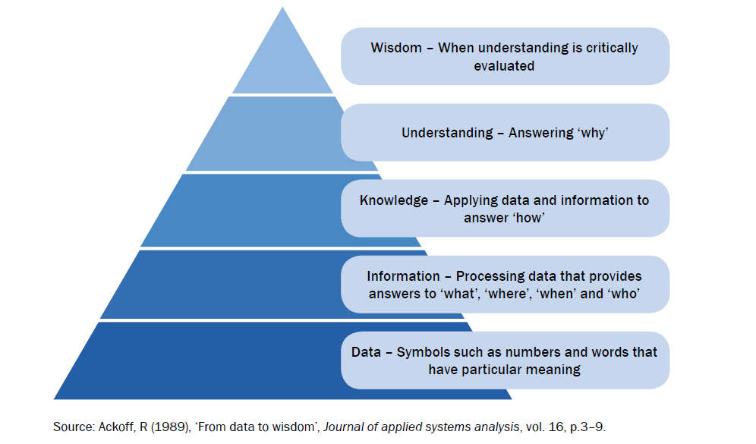
Relevancy and sufficiency of information

Slide 16
Using critical thinking to make decisions
Critical thinking is involved in each step of the decision-making model.
The table shows how alternative critical thinking techniques can be applied to the
decision-making process to ensure that the process is robust. The following intellectual
standards have been included to show how they can be used in the decision-making process.

Slide 17
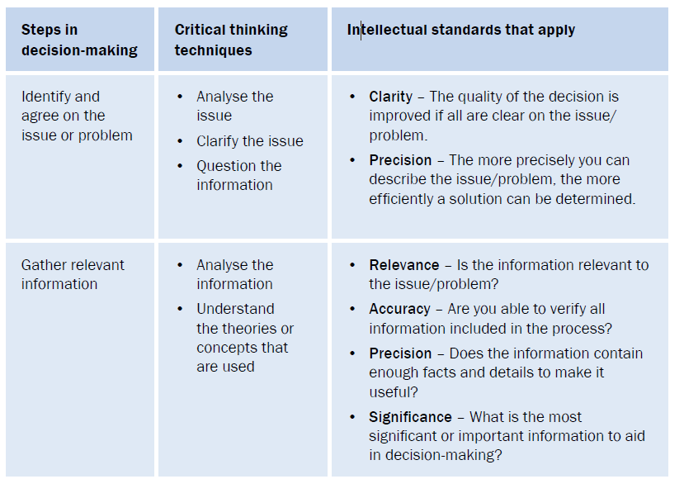
Risks Of Not Applying Critical Thinking
What are things you could apply critical thinking to avoid the following situations in a business?
having the same range of products and services year after year?
implementing a new process that drives away customers?

Slide 18
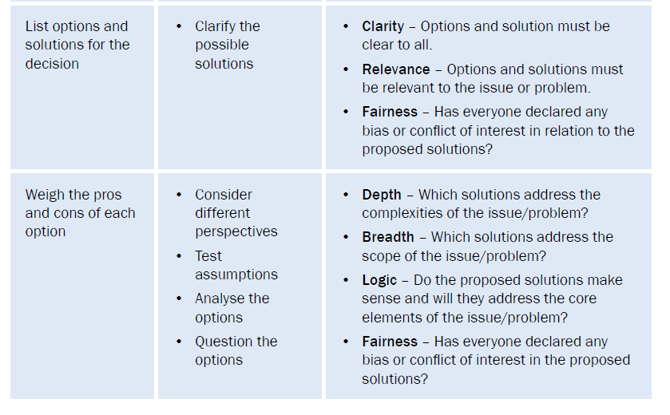
Risks Of Not Applying Critical Thinking
What are things you could apply critical thinking to avoid the following situations in a business?
having the same range of products and services year after year?
implementing a new process that drives away customers?

Slide 19
Effects If Critical Thinking Isn’t Applied
The list of examples of poor critical thinking is long. Weakness in critical thinking skill results in loss of opportunities, of financial resources, of relationships, and even loss of life. There is probably no other attribute more worthy of measure than critical thinking skills.

Slide 20
Customer Product Criteria
#1. Can I trust that your product will deliver according to what your advertising campaign says?
#2. Why should I buy your product instead of similar ones in the market? What does your product have that the others don’t?
#3. Do you understand what I need? Will your product fulfill that need?

Slide 21
Critical Thinking Process
The ultimate goal of decision making is to arrive at actionable conclusions, and critical thinking is the process that proves whether the conclusion is sound.

Slide 22
Critical Thinking Process
The Critical Thinking Process Involves 5 Steps
1. Identification – Identify the problem and define it accurately.
2. The Solution – Propose a potential solution.
3. Exploration – Create a potential action plan that results in the evaluation of the potential solution.
4. Action – Take the essential steps to complete and implement the action plan.
5. Reevaluate – Review the action plan to determine if it solved the identified problem.

